Slide 1
Wine Rating Predictions Machine Learning:
ASSIGNMENT 1 – ORAL PRESENTATION
By: Darlene Phan
Coding Dojo – Data Science

Slide 2

The Client:
A global wine supplier specializing in importing Spanish wines.
The Problem:
Looking to expand their wine catalogue by being able to rate potential new wines.
Our Mission:
To build a machine learning model that will help predict wine ratings based on its characteristics. This will allow our client can easily determine what new wines will have a place in their inventory.

Slide 3
Data Dictionary Breakdown
Country, Region & Vineyard
The geographical location vineyard the wine comes from. Also known as winery.
Body & Acidity (scale 1-5)
Body determines the weight or depth of the wine.
Acidity determines the tartness of the wine.
Price
Price per bottle of wine in Euros.
Wine Type & Wine Name
Type – Chardonnay, Grenache, Pinot Noir.
Wine Type as name – Trader Joes Charles Shaw Blend Merlot.
Rating
Rating of the wine given by its number of users.
Vintage (year)
The year in which the grapes are harvested. N.V. stands for non-vintage, generally means the wines are a blend of multiple vintages.

Slide 4
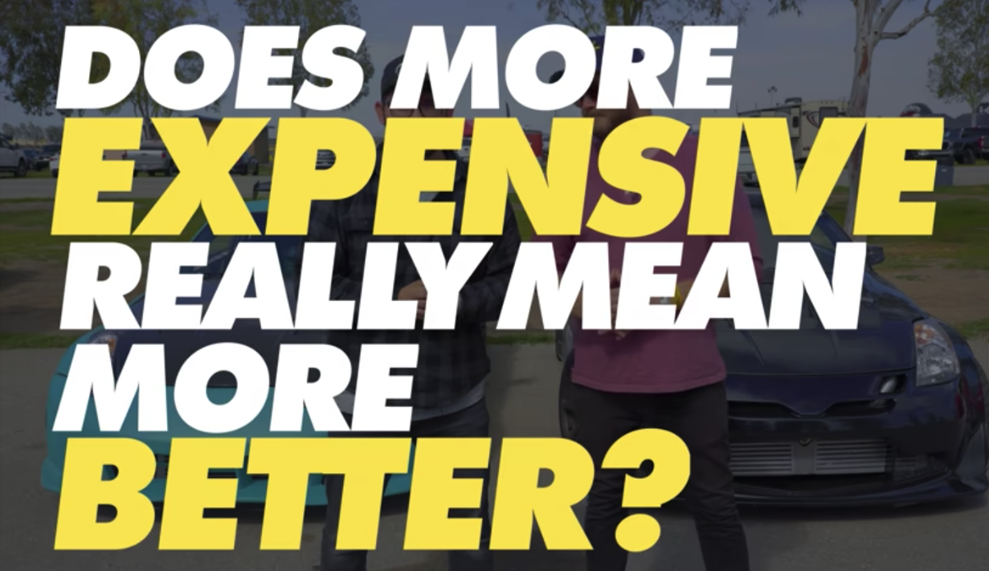
Unconscious Wine Bias
(Key Findings)
Does an older vintage
=
more expensive wine?
Does expensive wine
=
higher rated wine?
“But Darlene, I don’t have any biases when it comes to wine.”
Oh, but you do!
Contrary to popular belief, more expensive does not mean more better. Nor does it mean that older wines = higher price tags.
Side note: It is very important to note that, although this is funny, there is an article I came across on LinkedIn that talks about how our unconscious bias is hindering the growth of Data Science.

Slide 5
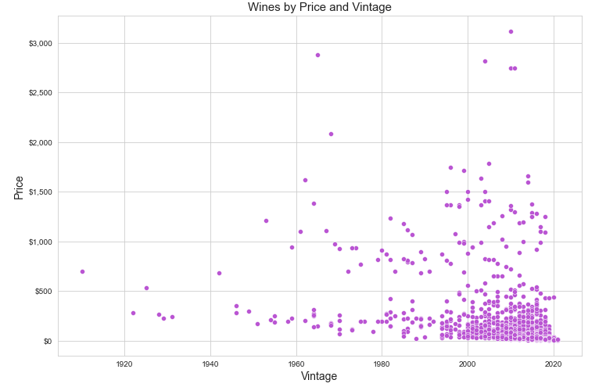
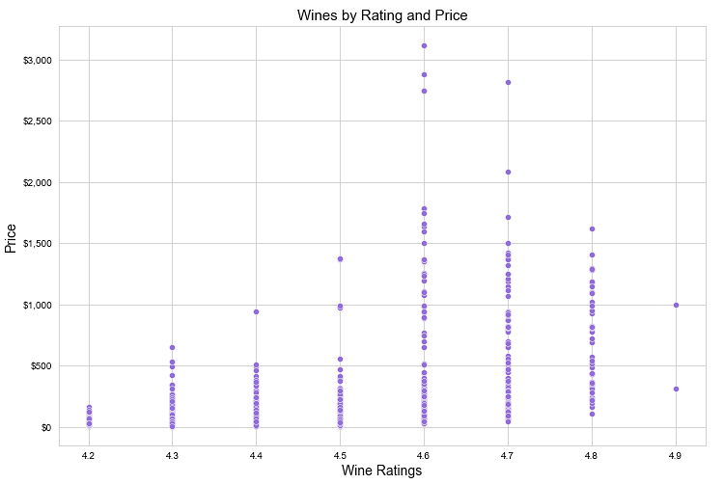



Vintages and Their Influence on Rating and Prices
(Key Findings)
Wine Vintages vs Prices:
Wine Rating vs Prices:
4 of 5 vintages are between 2005-2015
4 highest priced wines are rated at 4.7 or below.
Oldest wine vintage over 100 years old is under $1,000
2 highest rated wine are priced on par with lower priced wines.

Slide 6
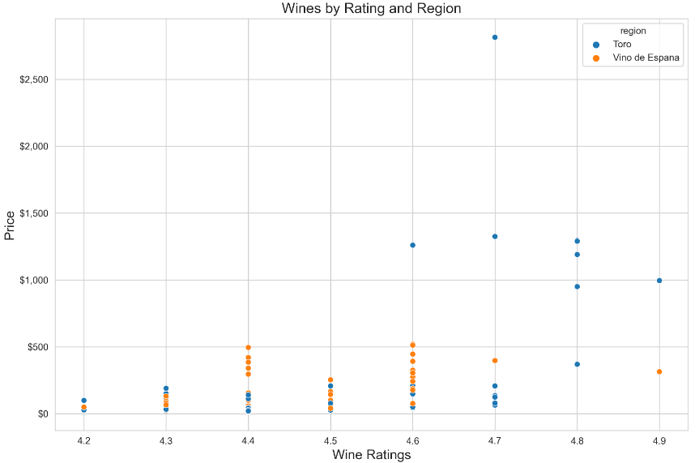

Model Limitations
Too Much Data and Not Enough Data
Too Many Categories Within Categories (Inception Categories):
704 different wineries
410 wine names
65 regions of Spain
793 reviews (not total reviews)
Having too many categories makes our machine learning model too specific, in turn makes it less accurate on making predictions.
Not Enough Data:
How our client rate wines compared to the users.
More characteristics to determine how wines should be rated.

Slide 7
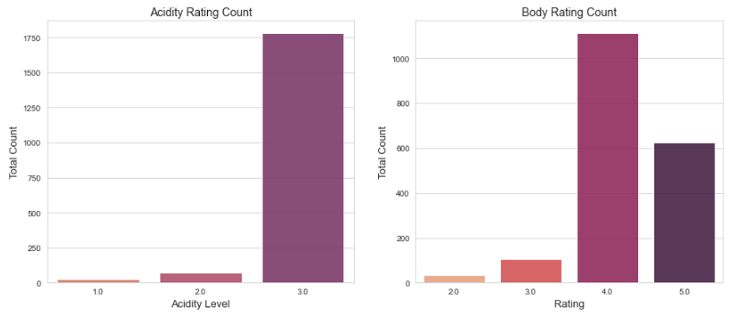
Models Strengths
Model Evaluation Metrics:
R2 Score RMSE Score
Our score: 64%
The higher the score the better.
Our score: 0.1
The lower the score the better.
Strengths
The client can deploy the model now and cut down on potential workload by 64%. With some adjustments to the model, there’s room to reduce labor by increasing the model's accuracy and efficiency.
Recommendations and Next Steps
Client's priorities.
Long-term short-term goals.
Identifying and strategize gathering of data to further improve the model.
Determine what metrics the users are utilizing to rate wines.

